Slide 1
EXCEPTION HANDLING IN ARM64
Saranya Chidura
21/4/2017

Slide 2
Exceptions
Exceptions are conditions or system events that require some action by privileged software to ensure smooth functioning of the system.
Different Type of exceptions are
Interrupts
Aborts
Reset
In Aarch64, Exceptions may be synchronous or asynchronous.

Slide 3
An exception is described as synchronous if it is generated as a result of execution or attempted execution of the instruction stream, and where the return address provides details of the instruction that caused it.
An asynchronous exception is not generated by executing instructions, while the return address might not always provide details of what caused the exception.

Slide 4
Some of exceptions are
FIQ – fast external interrupt request
FIQ are higher priority than IRQ.
IRQ - external interrupt request
Both FIQ ,IRQ are physical signals to the core. External hardware asserts an interrupt request line and the corresponding exception type is raised when the current instruction finishes executing.
Both are Asynchronous Exceptions as they are not directly related to the software being executed by the core at any given time.

Slide 5
Instruction Aborts
Sometimes instruction is aborted while in pipeline itself. The execution of instruction by core results in abort.
Failed instruction fetch results in exception.
If the pipeline is flushed before the aborted instruction reaches the execute stage of the pipeline, the abort exception will not occur.
Data Aborts
A data transfer instruction attempts to load or store data at an illegal address.

Slide 6
System errors
Physical interrupts
Asynchronous exceptions
Instruction and Data aborts are synchronous exceptions while external aborts generated by the memory system might be taken asynchronously using Serror Interrupts

Slide 7
Reset
Reset is treated as a special vector for the highest implemented Exception level.
This vector uses an IMPLEMENTATION DEFINED address.
RVBAR_ELn contains this reset vector address,
All cores have a reset input and take the reset exception immediately after they have been reset.
used to execute code on the core to initialize it, after power-up.

Slide 8
Exception Handling Registers
Exception Handling Registers
Saved Program Status Register(SPSR_ELn)
It stores the PSTATE Information (Current state of processor)
Processing Element state is saved in the SPSR at the Exception level the exception is taken to.
Exception Link Register (ELR_ELn)
It stores the return address from an exception.
The return address is saved in the ELR at the Exception level the exception is taken to.
On return, the PC is restored to the address stored in the ELR

Slide 9
Exception Syndrome Register (ESR_ELn)
gives information about the reasons for the synchronous exception.
IRQ or FIQ as these interrupt handlers typically obtain status information from registers in the Generic Interrupt Controller
Fault Address Register (FAR_ELn)
holds the faulting virtual address for all synchronous instruction and Data Aborts and alignment faults.

Slide 10
Exception Entry
The Processing Element state is saved in the SPSR_ELx at the Exception level the exception is taken to.
The preferred return address is saved in the ELR_ELx at the Exception level the exception is taken to.
All of PSTATE.{D, A, I, F} are set to 1.
If the exception is a synchronous exception or an SError interrupt, information characterizing the reason for the exception is saved in the ESR_ELx at the Exception level the exception is taken to.
Execution moves to the target Exception level, and starts at the address defined by the exception vector.
Notes:
Exception Bit Mask Bits allow the exception events to be masked. The exception is
not taken when the bit is set.

Slide 11
Aarch64 Exception Table
When an exception occurs, the processor must execute handler code which corresponds to the exception.
The location in memory where the handler is stored is called the Exception Vector.
Exception vectors are stored in a table, called the Exception Vector table.
Each Exception level has its own vector table.
The virtual address of each table base is set by the Vector Base Address Registers( VBAR_Eln).

Slide 12
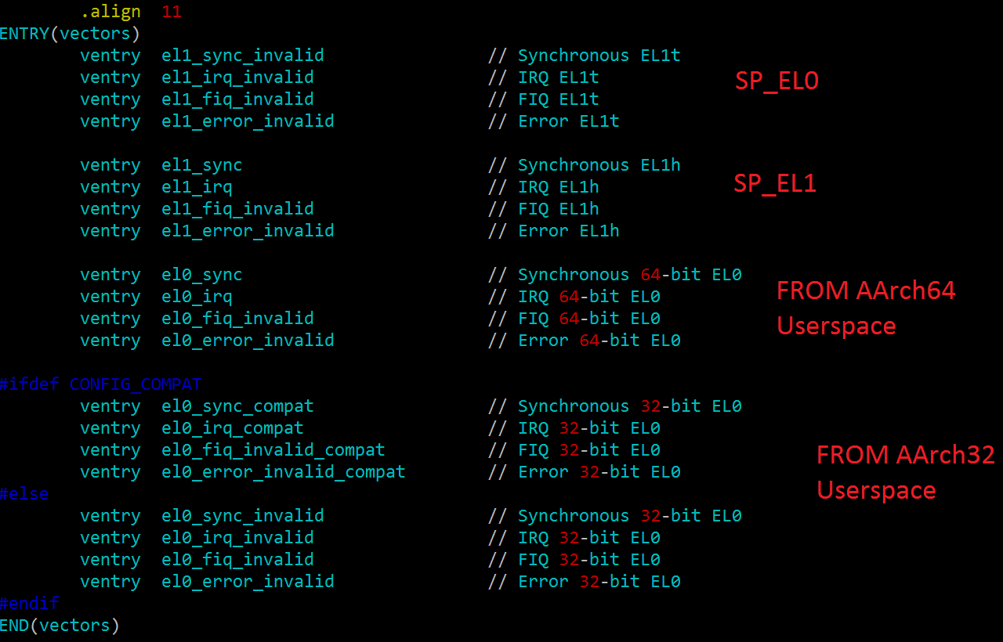
Each entry in the vector table is 16 instructions long.
It has a defined offset from this base address.

Slide 13
Which entry is used depends upon a number of factors:
The type of exception (SError, FIQ, IRQ or Synchronous)
If the exception is being taken at the same Exception level, the Stack Pointer to be used (SP0 or SPx)
If the exception is being taken at a lower Exception level, the execution state of the next lower level (AArch64 or AArch32)
Exception Vector table is defined in arch/arm64/kernel/entry.S
It is allocated during boot time at arch/arm64/kernel/head.S .
VBAR_EL1 contains the vector table base address.
Notes:
LSB 6 bits in the ESR for exceptions indicates the DFSC(Data Fault Status Code.)

Slide 14
Examples:
Segmentation fault by a user application.
Segmentation fault by a kernel module.

Slide 15
Exceptions are never taken to EL0
On taking an exception the EL can stay the same OR get higher.
Asynchronous exceptions can be routed to higher ELs.
SCR_EL3 – specifies exceptions to be routed to EL3
HCR_EL2 – specifies exceptions to be routed to EL2.
For asynchronous exceptions, the ELR_ELn points to the address of the first instruction that has not been executed, or executed fully, as a result of taking the interrupt

Slide 16
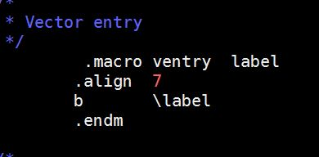
Reference for assembly code:
The adr_l loads program relative address into register
The msr move arm register value into system register
The b branch to the label
The stp store pair of registers
The ldp load pair of registers
#ifndef ENTRY
#define ENTRY(name)
.globl name ASM_NL
ALIGN ASM_NL
name:
#endif

